Slide 1

Introduction to programming in Python
Fall 2018-19
Department of Software and Information Systems Engineering
Ben-Gurion University of the Negev
Lecture 3: functions, simulation

Slide 2
HW-related issues
Test cases and automated testing system
Technical:
Assume input is correct unless told otherwise
Structure of code according to hw1.py (functions..)
How to create .py file from Jupyter NB and execute it in Spider
Style:
Comment
Meaningful variable names

Slide 3
Programming style: variables names
When defining variables, we want to give meaningful names
This is important for us to track our code, and for our co-workers
Remember the program from the last session?
x = 70
y= 172
z = y/ 100
r = x / (z ** 2)
weight = 70
height_cm = 172
height_m = height_cm / 100
BMI = weight / (height_m ** 2)
VS.
Note: In python it is common to write names separated by underscore: height_cm and not heightCm as in other programming language.

Slide 4
Programming style: comments
Comments are the main way to document and explain our code.
A comment line is defined by ‘#’ as the first character of the line.
The “interpreter” will ignore comment line in runtime.
# BMI calculation based on the weight and height
# The input is converted to int - as python reads it as string
weight = int(input(“Enter your weight”))
height_cm = int(input(“Enter your height”))
# Height conversion – from centimeters to meters
height_m = height_cm / 100
BMI = weight / (height_m ** 2)

Slide 5
Last lesson
Conditional statements
Iterations: range, for / while loops, lists

Slide 6



Several ways to generate lists
Explicit
List comprehension
Loop
Casting
Slicing an existing lists (next)

Slide 7
Lists and Strings – Summary
Both lists and strings are examples for sequences (ordered collections) in Python
Both can be indexed and sliced
This is true for other sequences in Python as well

Slide 8
Plan for today
Functions
What are they good for
Built-in Functions
Defining New Functions
Simulation

Slide 9
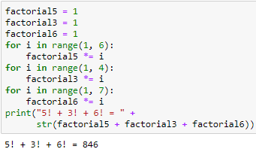
How to Calculate 5! + 3! + 6!?
Code Duplication

Slide 10
Code duplications are bad
Duplicated bugs (harder to fix later)
Longer programs
Copy & Paste errors
Rule of Thumb - write the code once!
Use it several times with different arguments

Slide 11
What is a function in programming ?
A function is a block of organized, reusable code that is used to perform a single, well defined action
Function’s inputs determines the outputs
Specific input is called an argument of a function
Functions provide better modularity for your application and a high degree of code reusing

Slide 12
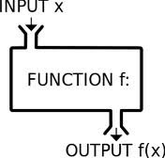
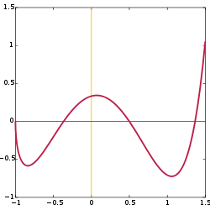
Function – definition II
A named sequence of statements that performs a specific task independently of the remaining code

Slide 13

Modularity
Ernie wrote code calculating a^{b}.
To use the code in 8 different calculations, he:
copy & pasted
assigned arguments
Eight times
Bert came up with a more efficient algorithm to calculate a^{b}
To update Ernie’s code, he went over the eight calculations ☹

Slide 14

Modularity enables code reuse!
Modularity is the degree to which a system's components may be separated and recombined (Wikipedia)
Top-down design
Improves maintainability
Enforces logical boundaries between components

Slide 15
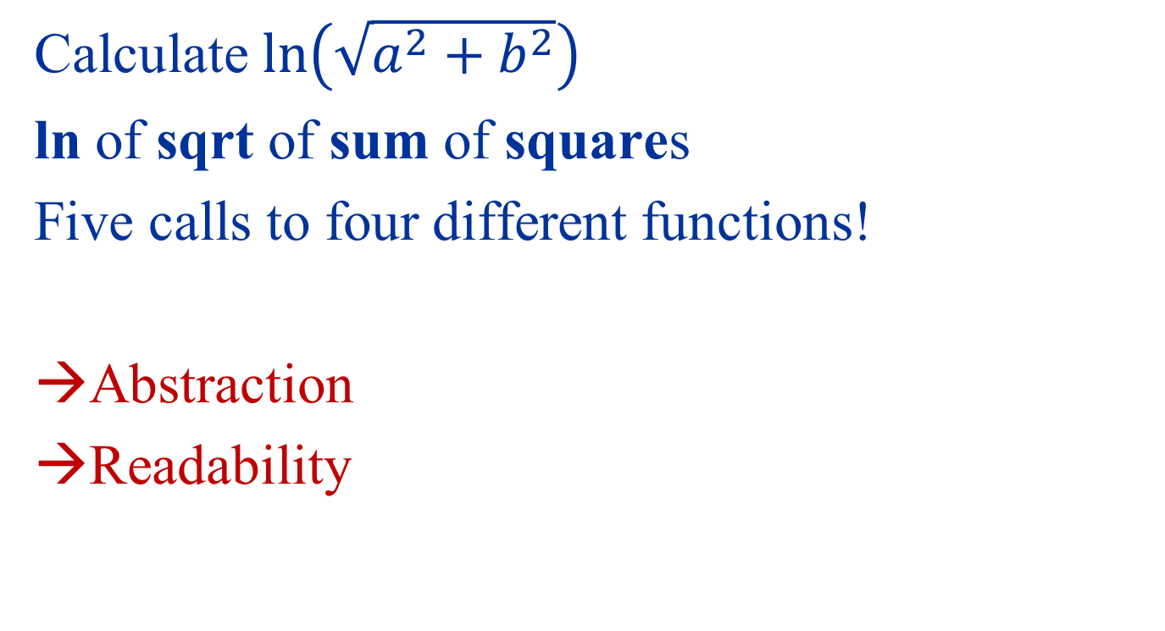
Abstraction - example
Calculate $\ln\left(\sqrt{a^{2}+b^{2}}\right)$
ln of sqrt of sum of squares
Five calls to four different functions!
Abstraction
Readability

Slide 16
So – why use functions?
Modularity - Break a task into smaller sub-tasks (divide and conquer), enables code reuse
Abstraction – Solve each problem once and wrap it in a function
Maintenance - Solve bugs once
Readability – Main code is shorter, implementation details are hidden within functions

Slide 17
Plan for today
Simulation
Functions
What are they good for
Built-in Functions
Defining New Functions

Slide 18
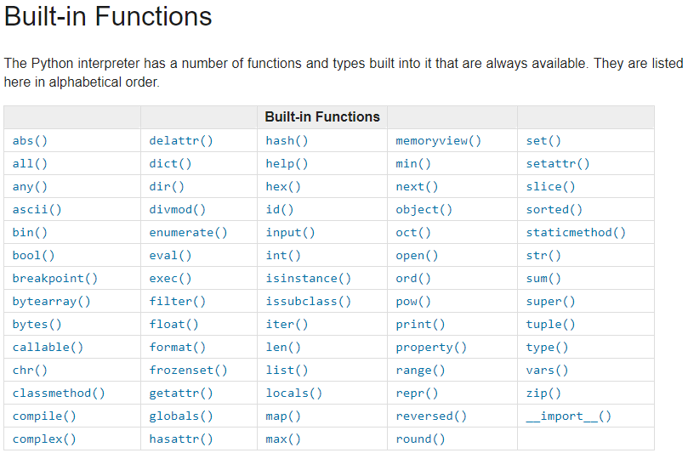
Built-in functions
http://docs.python.org/library/functions.html

Slide 19
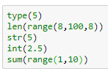
We already called built-in functions

Slide 20


Math functions
Pre-defined constant
Pre-defined functions contained in the imported math module
What is ‘math’?
Where did it come from?
What functionality is available?

Slide 21
Plan for today
Functions
What are they good for
Built-in Functions
Defining New Functions
Simulation

Slide 22
Defining a new function in Python
Function definition
Function name
Arguments (=Parameters)
Defining the function
def is_over_100(x):
if x > 100:
return True
else:
return False
Using the function
>>> is_over_100(50)
False
>>> is_over_100(150)
True
Function Body
Indentation!
Return Value
Short definition:
def is_over_100(x):
return x > 100

Slide 23
Functions
def function_name(argument1, argument2,...):
statement1
statement2
…
return result1, result2, …
# return is optional!
# if return is not specified, the function
# returns the constant None
Calling a function:
var1, var2,… = function_name(val1, val2,...)

Slide 24
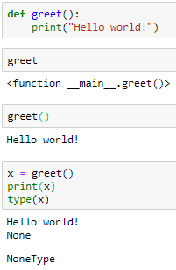
Example
Functions have values
Nothing Returned

Slide 25
Function input / output
Input: arguments
Any type: int / float / str / Boolean / list
Output: the return command
Returns a value to the function’s caller
returned value – any Python type
No returned value - returns None
return stops immediately the function’s execution and returns to the caller!
(return is different from print!)

Slide 26
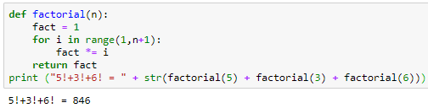
Back to the factorial example Avoiding code duplication
Calculate 5! + 3! + 6! Using a function:
Calling the function from the main script or from another function
Defining a new function
n, fact and i are called “local variables” – they exist only within the scope of the function and disappear when it ends
(we’ll explain why later..)

Slide 27
Palindromes
Palindrome: a string w satisfying w = w^{R} (string equals its reverse )
“Madam I'm Adam"
”Dennis and Edna sinned"
“Red rum, sir, is murder"
“Able was I ere I saw Elba“
(cheated a bit by ignoring spaces as well as lower/upper case…)
Palindromes appear in nature. For example as DNA restriction sites - short genomic strings over {A,C,T,G} being cut by (naturally occurring) restriction enzymes
Longest Palindrome in Hebrew (2013): http://www.haaretz.co.il/news/education/1.1940711

Slide 28
Example - Palindromes
Pseudo-code
Translate a verbal description to code.
For every index in the string:
Check if the i^{th} letter is equal to the (n-i)^{th} letter
If not return False (this is not a palindrome)
If all indices were verified – this is a palindrome!

Slide 29
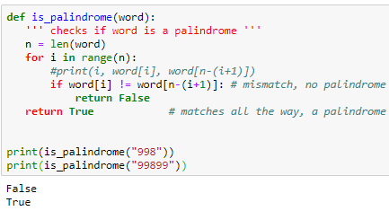
Identify Palindromes: implementation
Input: word, a string of length n.
How many iterations will the function is_palindrome take to execute on word?

Slide 30
Run time analysis to identify Palindromes Depends not only on the length of word, but also on the word itself
In the best case (from runtime point of view), word[0] and word[n-1] are not equal. In this case, the execution will terminate after one comparison.
In the worst case (again, from runtime point of view), word is a palindrome. In this case, the execution will terminate after n comparisons.
You may wonder what will the average case looks like. To answer it, we should know something about the distribution of inputs. (later)

Slide 31

A more elegant implementation

Slide 32
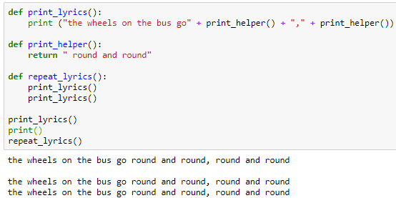
Functions can call other functions

Slide 33
Plan for today
Functions
What are they good for
Built-in Functions
Defining New Functions
Simulation
Bonus!

Slide 34
Approximating square root – Newton’s method
Given n > 0, can we find an approximation of n?
Newton noticed that for any positive n, the following series converges to n for any initial guess x₀:

Slide 35
Algorithm
Algorithm
Guess x
Improve the guess by averaging x, n/x
Improve until the guess is close enough
Example: calculate the square root of 2
x = 1
n/x = 2
x = ½ (1+ 2) = 1.5
n/x = 4/3
x = ½ (3/2 + 4/3) = 17/12 = 1.416666
n/x = 24/17
x = ½ (17/12 + 24/17) = 577/408 = 1.4142156

Slide 36
Implementation plan
Input
An integer n > 0
The required accuracy (float)
Output
Approximation of n within the required accuracy.
Accuracy measurement
The absolute difference between n and n/x using Python’s abs function

Slide 37
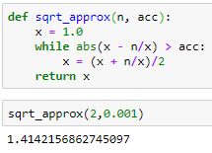
Implementation

Slide 38
Fast exponent algorithm
Ernie calculated a^{b} = a*a*a*… *a b times.
Bert noticed that:
If b is even: a^{b} = (a²)^{b/2} →Save b/2 – 1 multiplications
If b is odd: a^{b} = a*a^{b-1}
Complexity
Ernie – b multiplications
Bert – log₂ b multiplications – much faster!

